Slide 1
Muscles of the Thigh

Slide 2
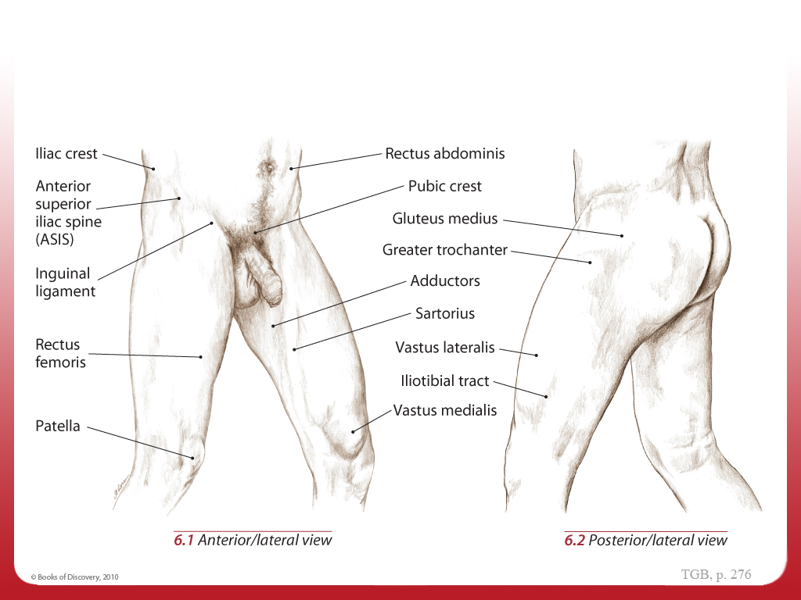
Topographical Views 1
Topographical Views

Slide 3
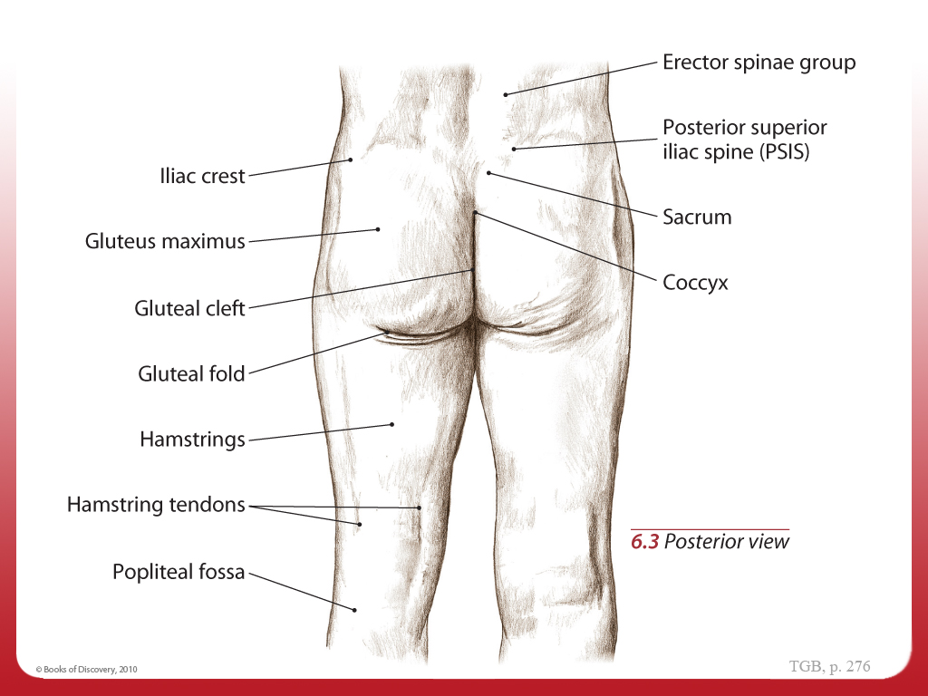
Topographical Views 2
Topographical Views

Slide 4
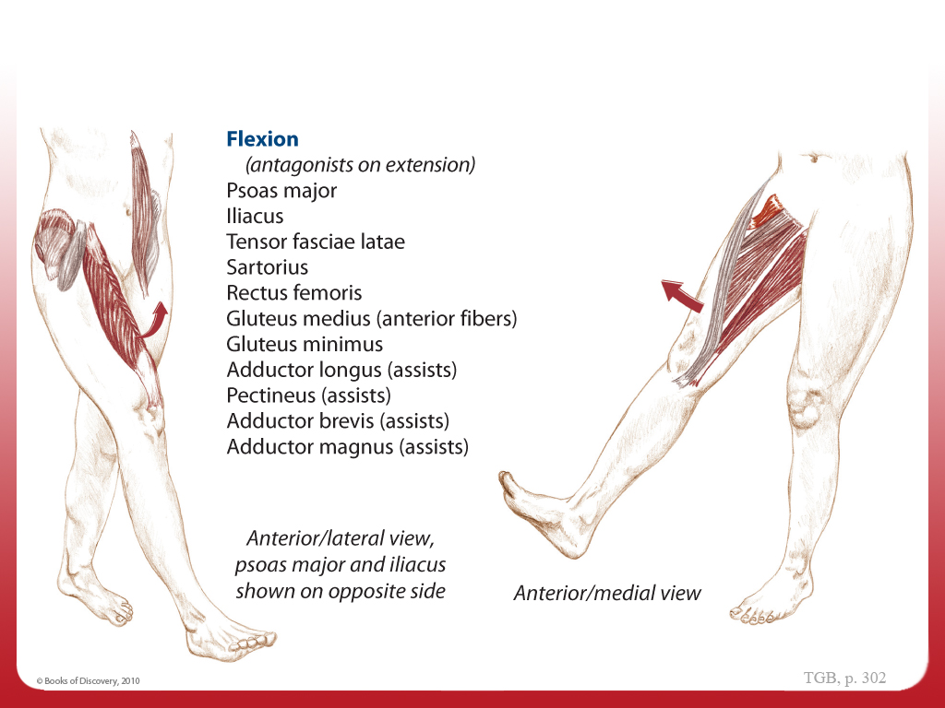
Synergists - Coxal, Flexion
Synergists – Muscles Working Together
Coxal
(hip joint)

Slide 5
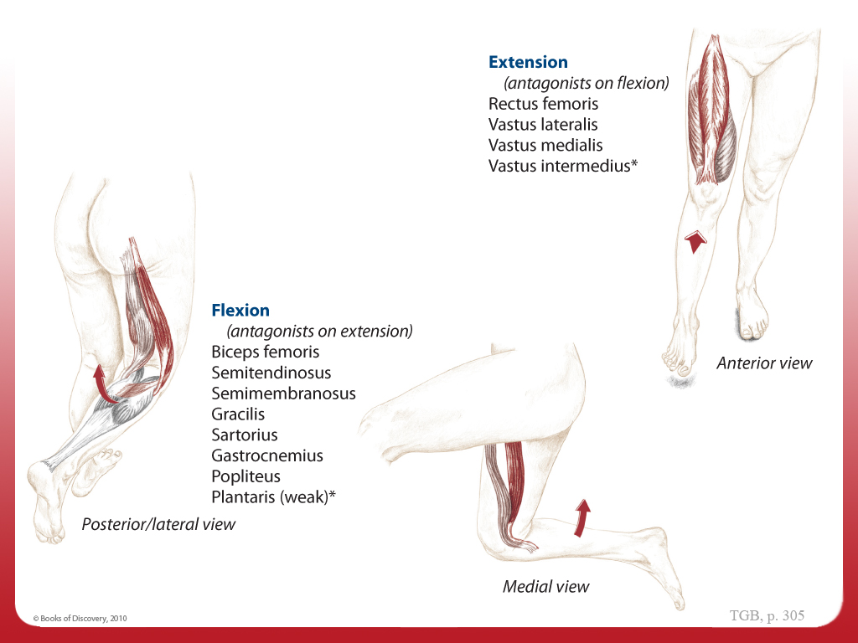
Synergists - Knee, Flexion & Extension
Knee
(tibiofemoral joint)

Slide 6
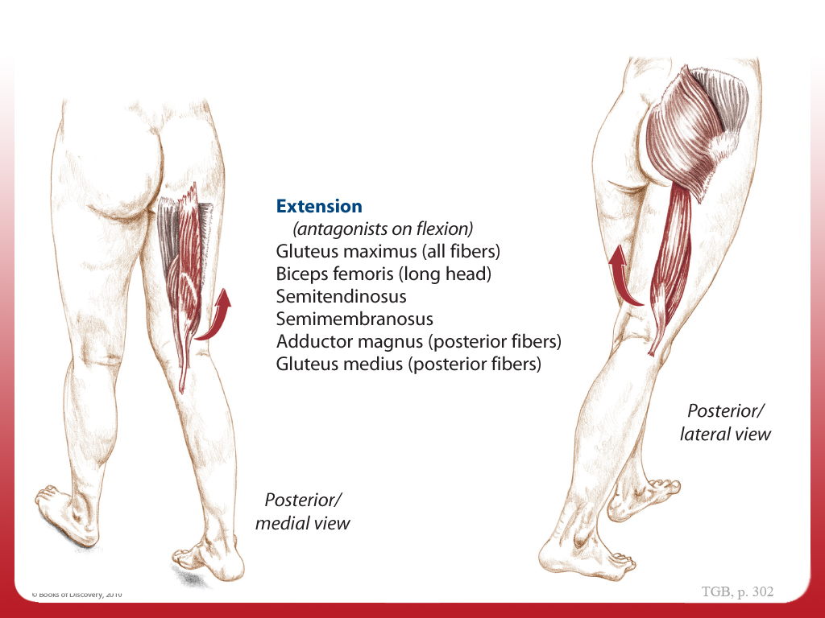
Synergists - Coxal, Extension
Coxal
(hip joint)

Slide 7
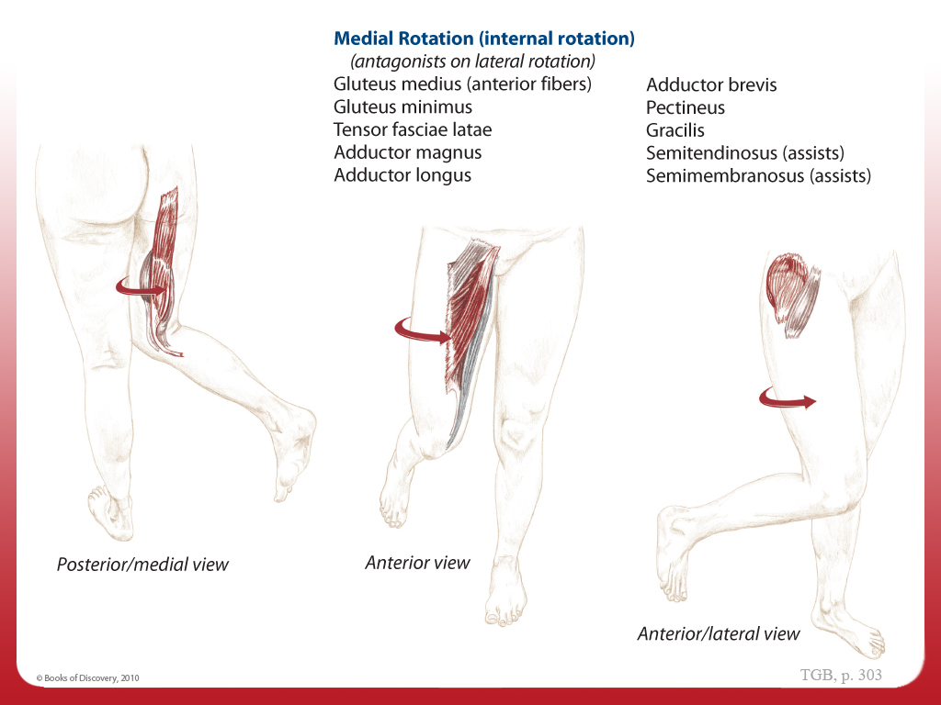
Synergists - Coxal, Medial Rotation
Coxal
(hip joint)

Slide 8
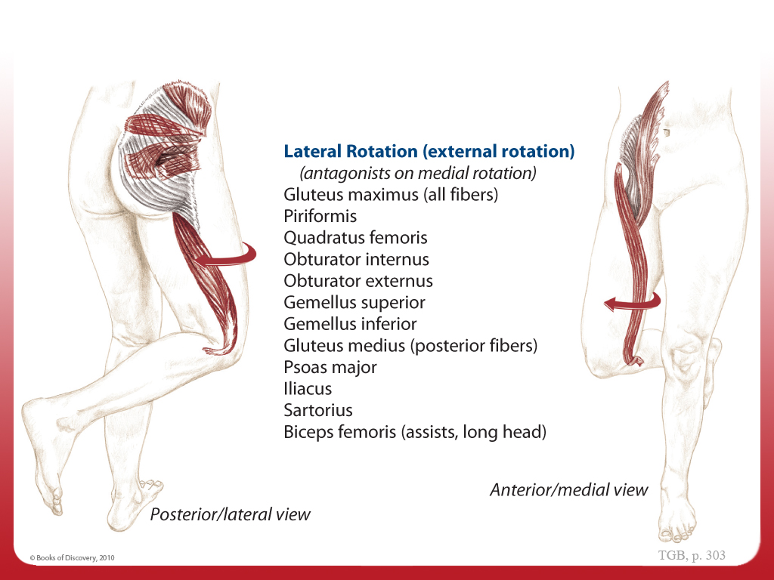
Synergists - Coxal, Lateral Rotation
Coxal
(hip joint)

Slide 9
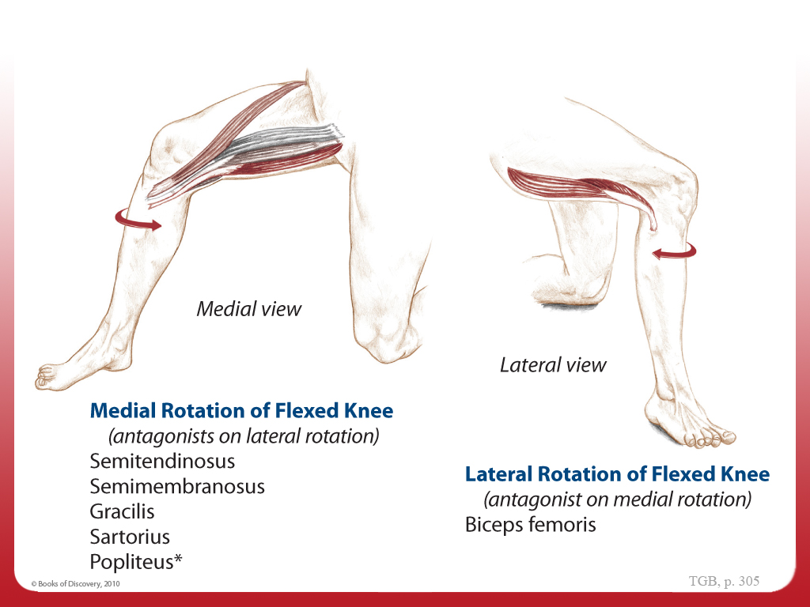
Synergists - Knee, Medial & Lateral Rotation of Flexed Knee
Knee
(tibiofemoral joint)

Slide 10
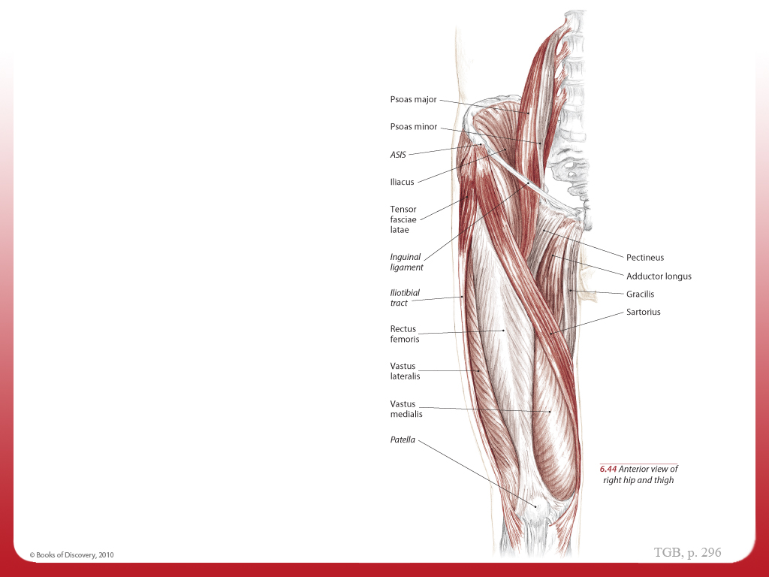
Muscles of the Pelvis and Thigh - Anterior
Muscles of the Pelvis and Thigh

Slide 11
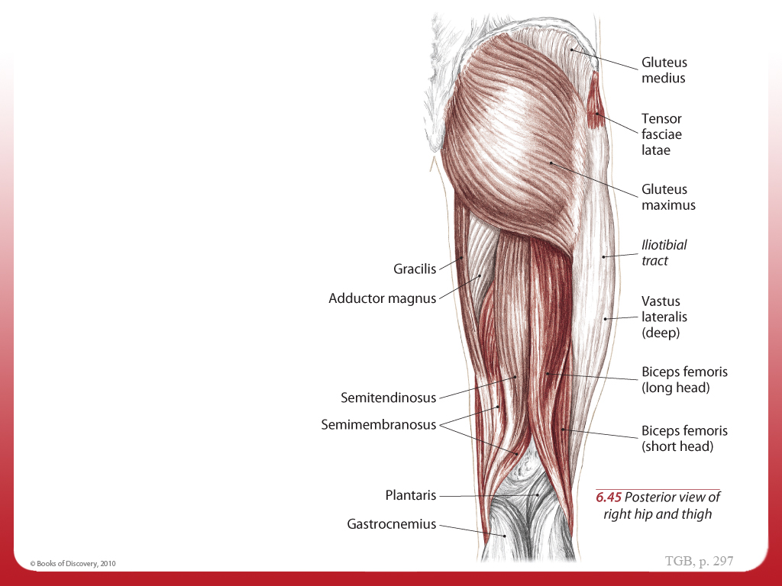
Muscles of the Pelvis and Thigh - Posterior
Muscles of the Pelvis and Thigh

Slide 12
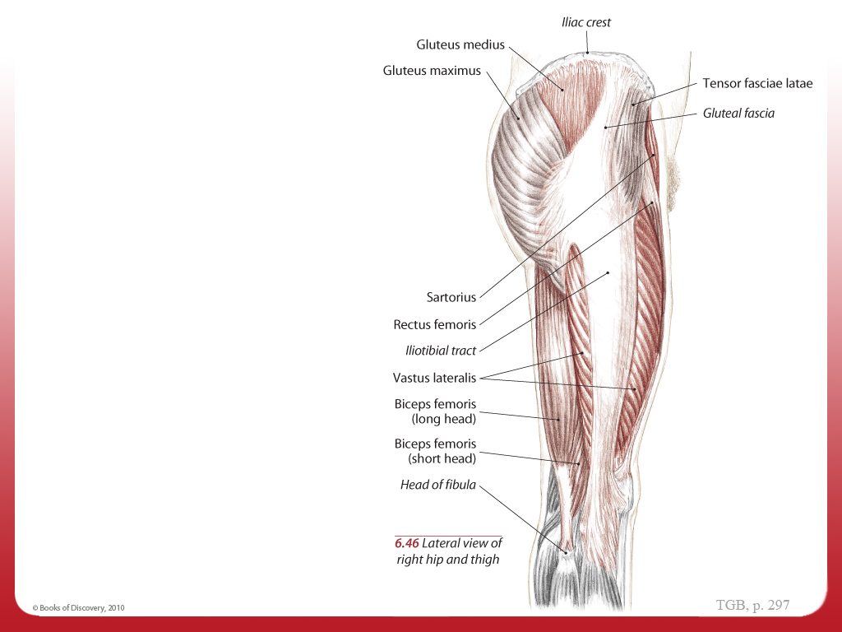
Muscles of the Pelvis and Thigh - Lateral
Muscles of the Pelvis and Thigh

Slide 13
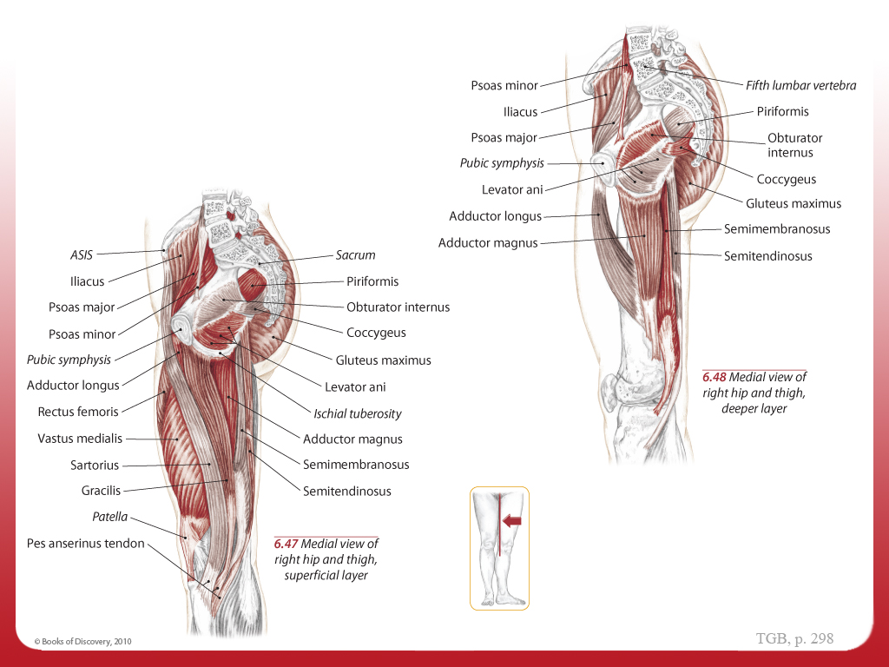
Muscles of the Pelvis and Thigh - Medial
Muscles of the Pelvis and Thigh

Slide 14
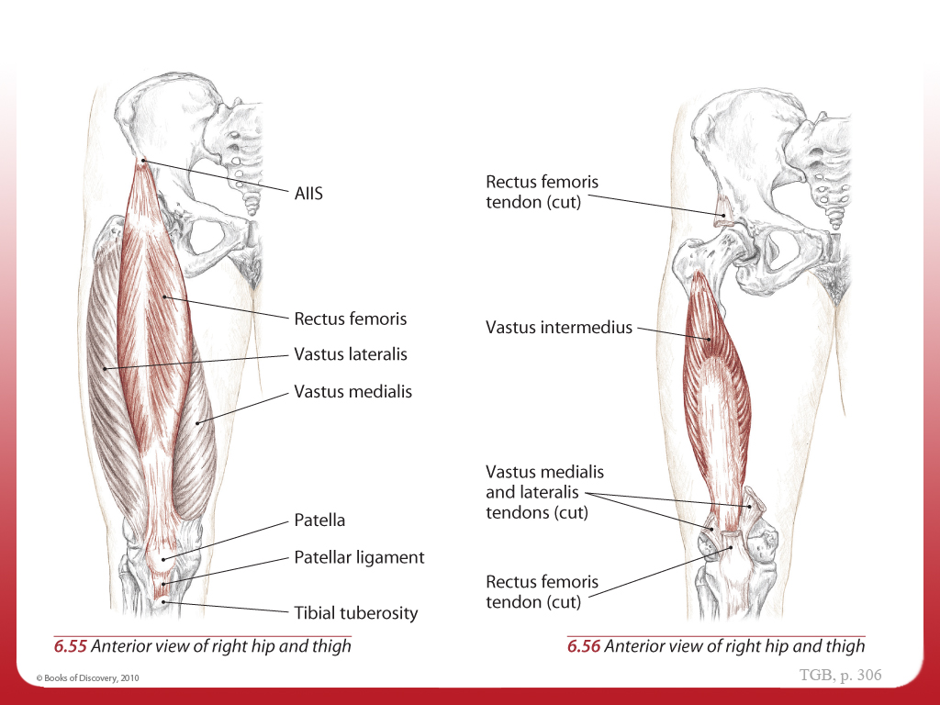
Quadriceps Femoris Group - Anatomy
Quadriceps Femoris Group

Slide 15
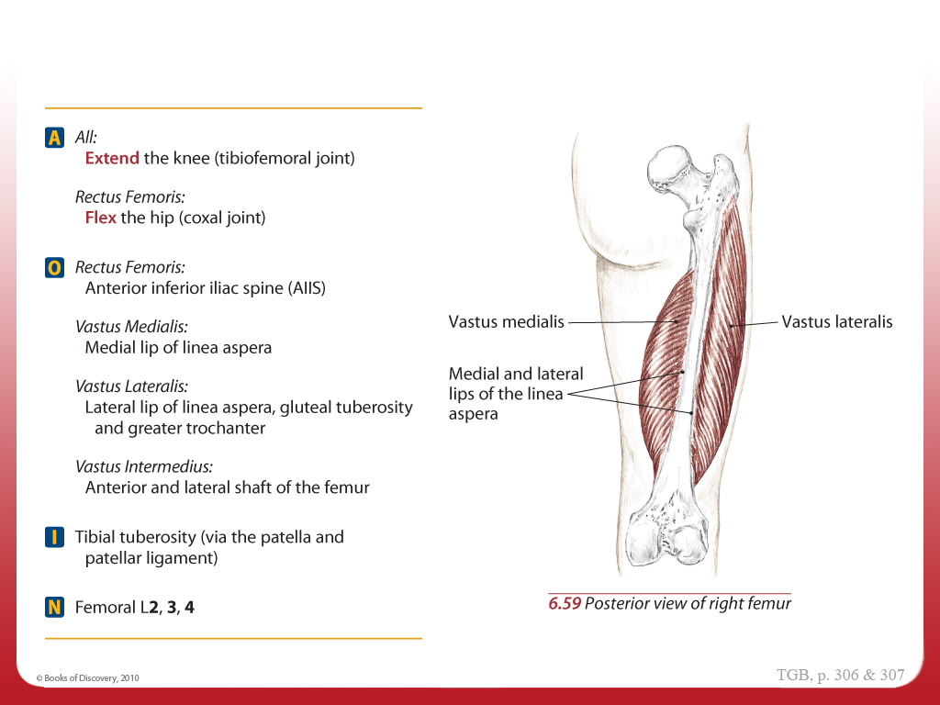
Quadriceps Femoris Group - AOIN
Quadriceps Femoris Group

Slide 16
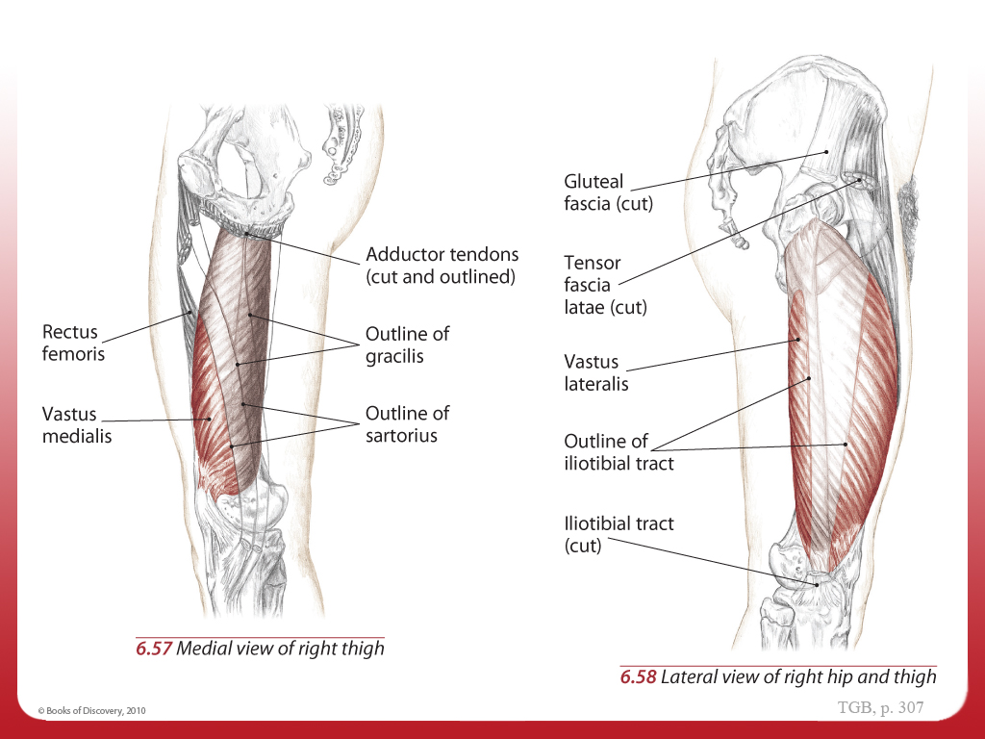
Quadriceps Femoris Group - Anatomy
Quadriceps Femoris Group

Slide 17
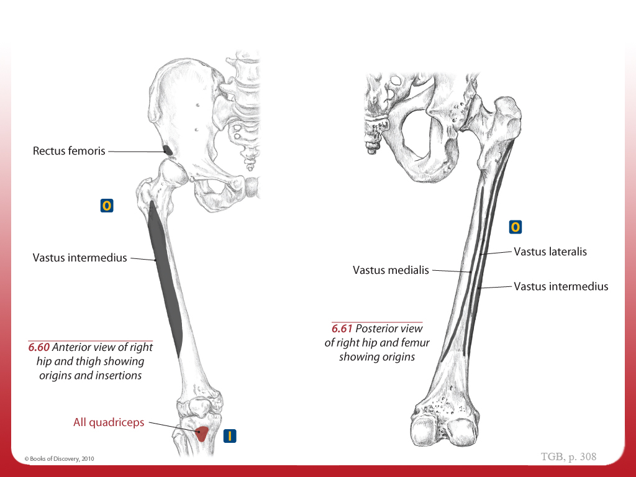
Quadriceps Femoris Group - O and I
Quadriceps Femoris Group

Slide 18
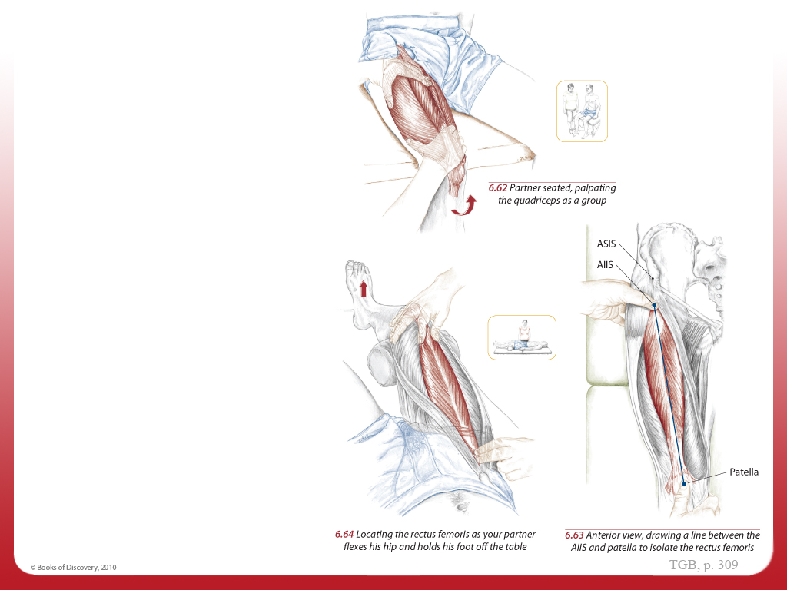
Quadriceps as a Group & Rectus Femoris - Palpate
Quadriceps as a Group
Text
Rectus Femoris

Slide 19
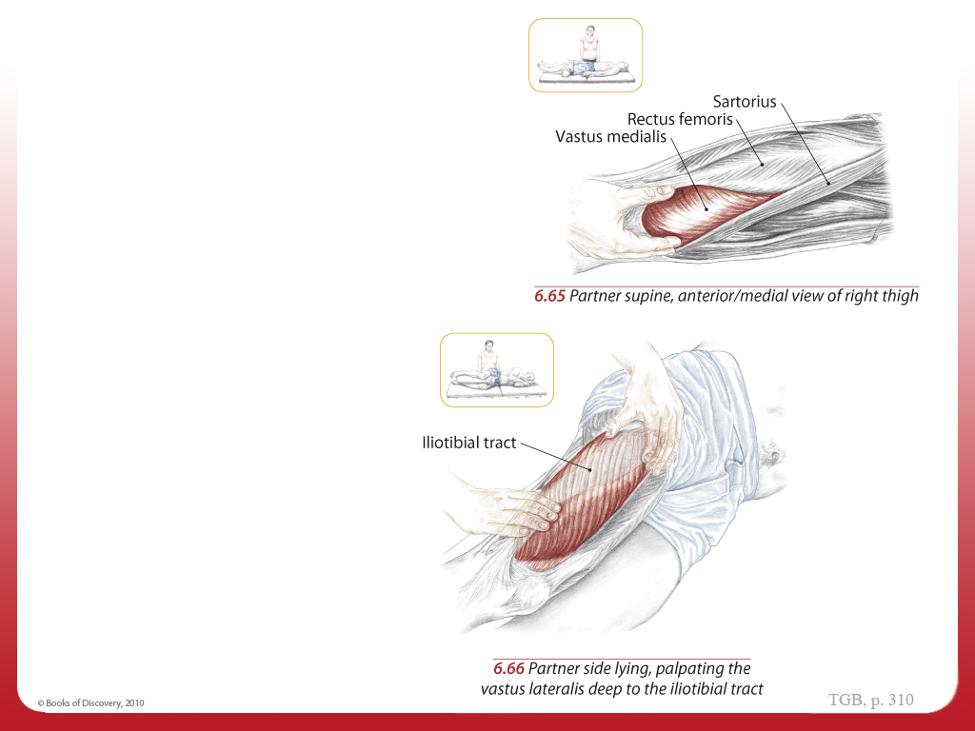
Vastus Medialis & Vastus Lateralis - Palpate
Vastus Medialis
Text
Vastus Lateralis
Text

Slide 20
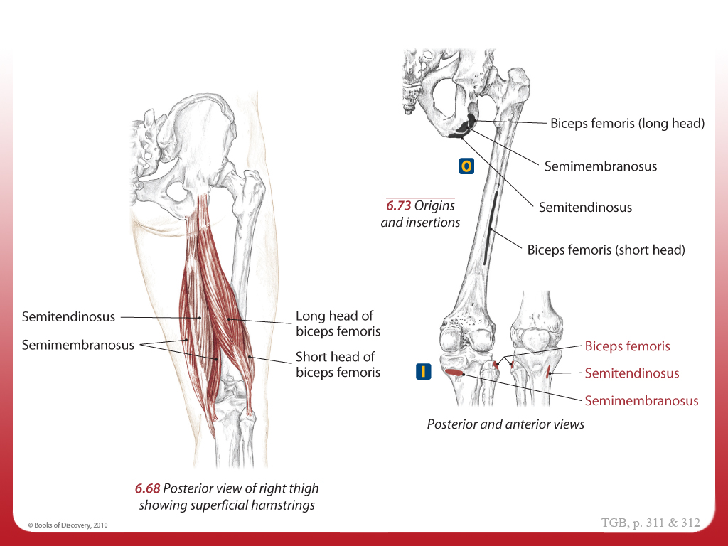
Hamstrings, Anatomy/O and I
Hamstrings

Slide 21
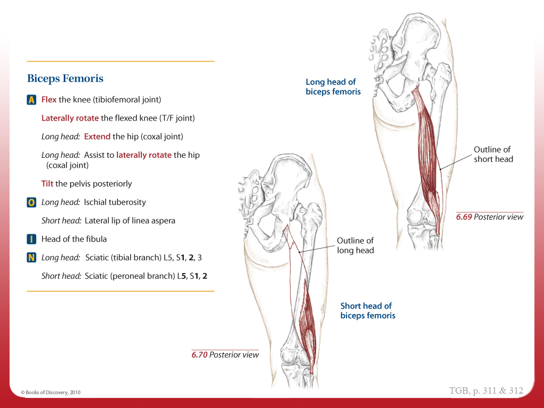
Hamstrings, Biceps Femoris - AOIN
Hamstrings

Slide 22
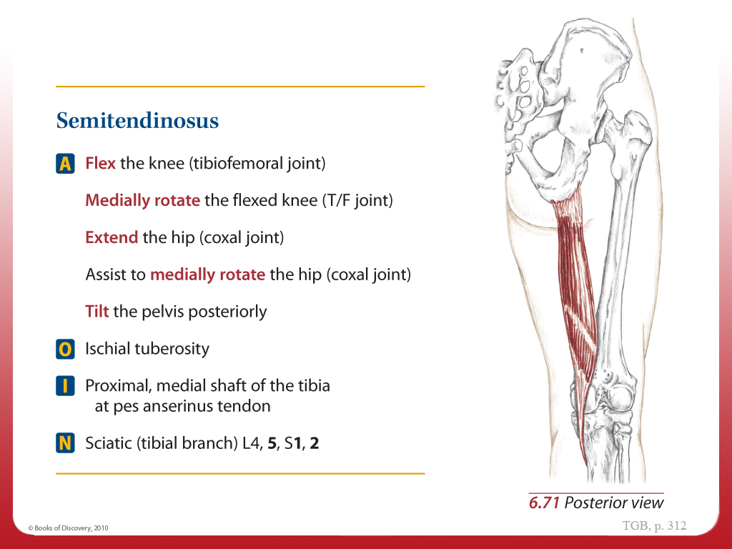
Hamstrings, Semitendinosus - AOIN
Hamstrings

Slide 23
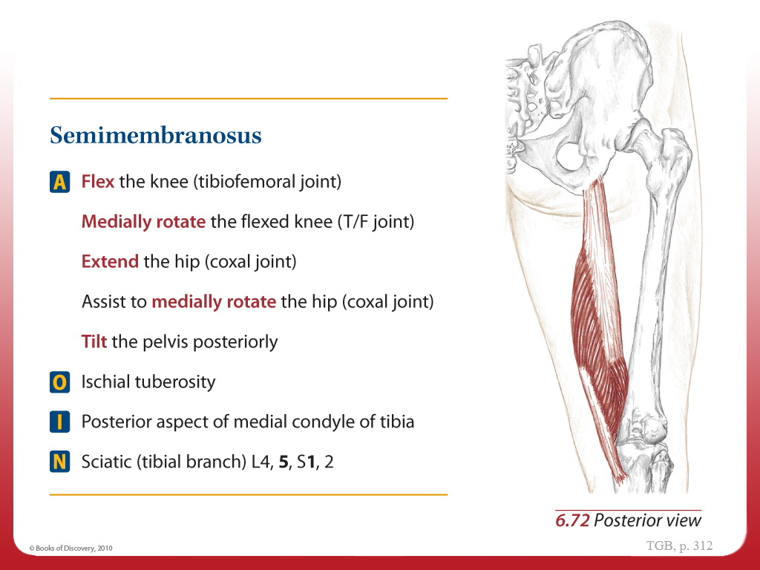
Hamstrings, Semimembranosus - AOIN
Hamstrings

Slide 24
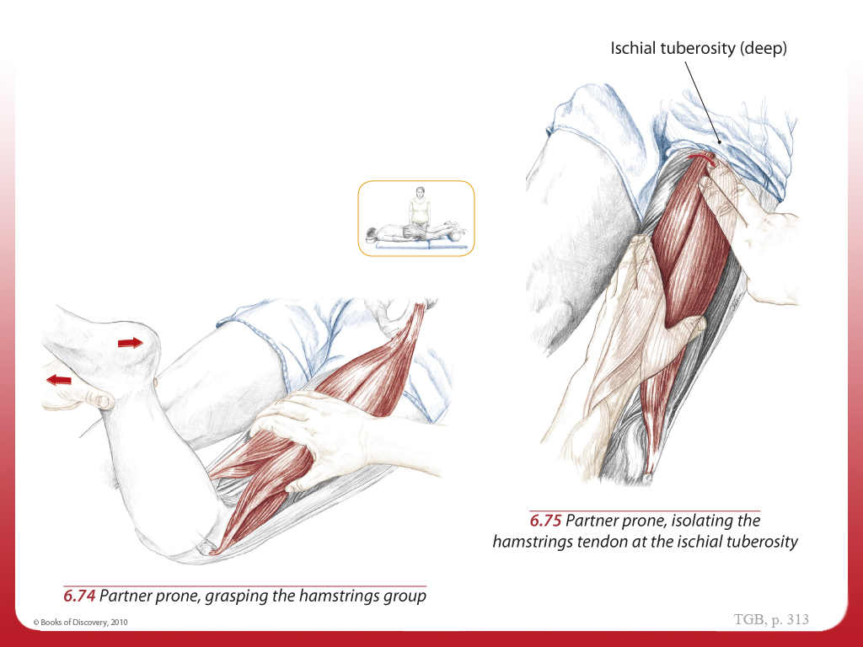
Hamstrings as a Group - Palpate
Hamstrings as a Group
Text

Slide 25
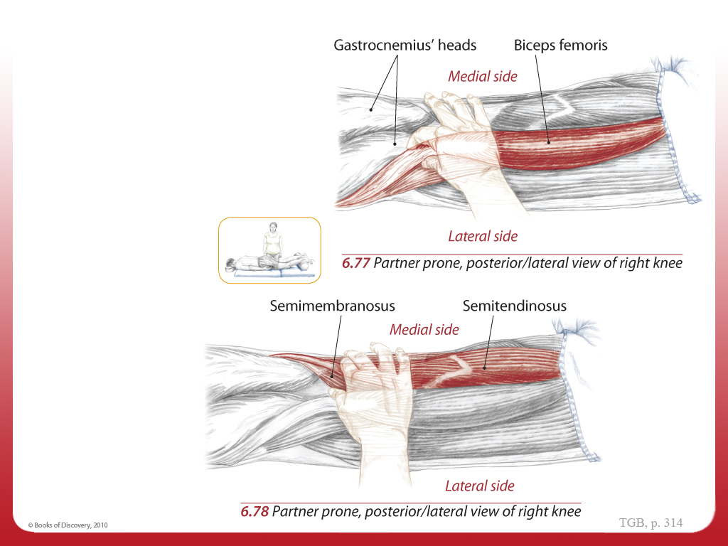
Individual Bellies and Distal Tendons - Palpate
Individual Bellies and Distal Tendons
Text

Slide 26
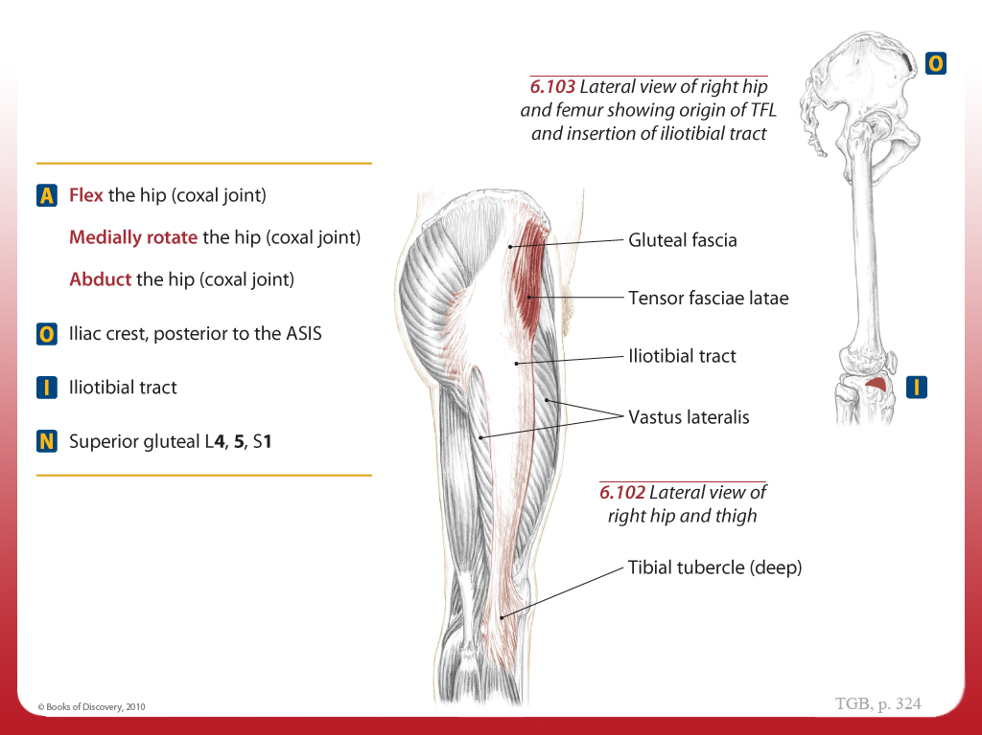
Tensor Fasciae Latae and Iliotibal Tract - AOIN/O and I
Tensor Fasciae Latae and Iliotibial Tract

Slide 27
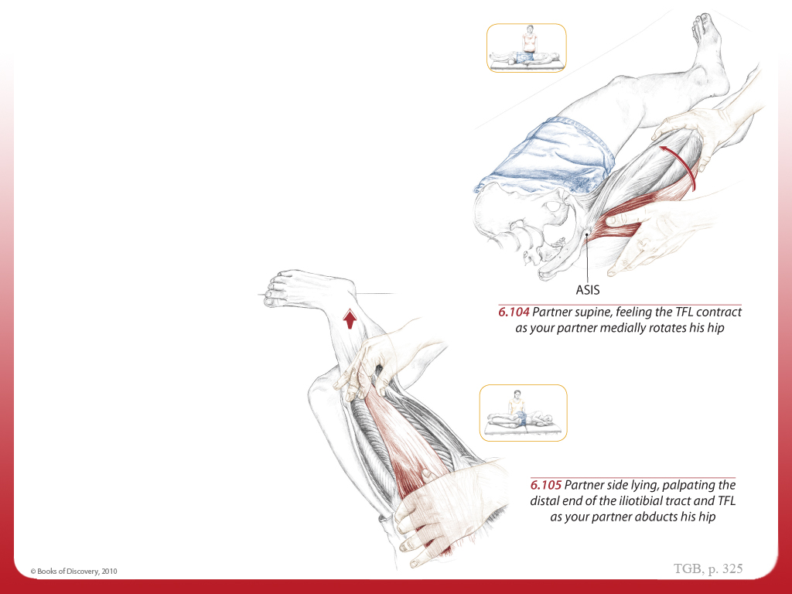
TFL & Distal End of the Iliotibial Tract - Palpate
Tensor Fasciae Latae
Distal End of the Iliotibial Tract

Slide 28
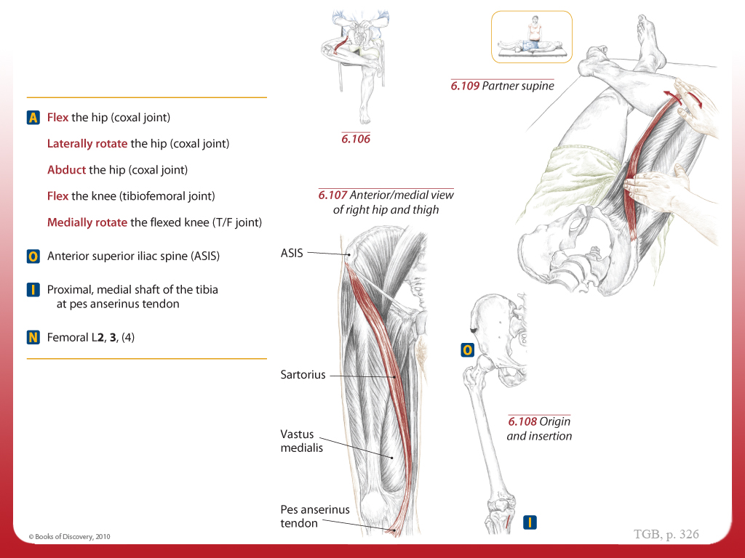
Sartorius - AOIN
Sartorius

Slide 29
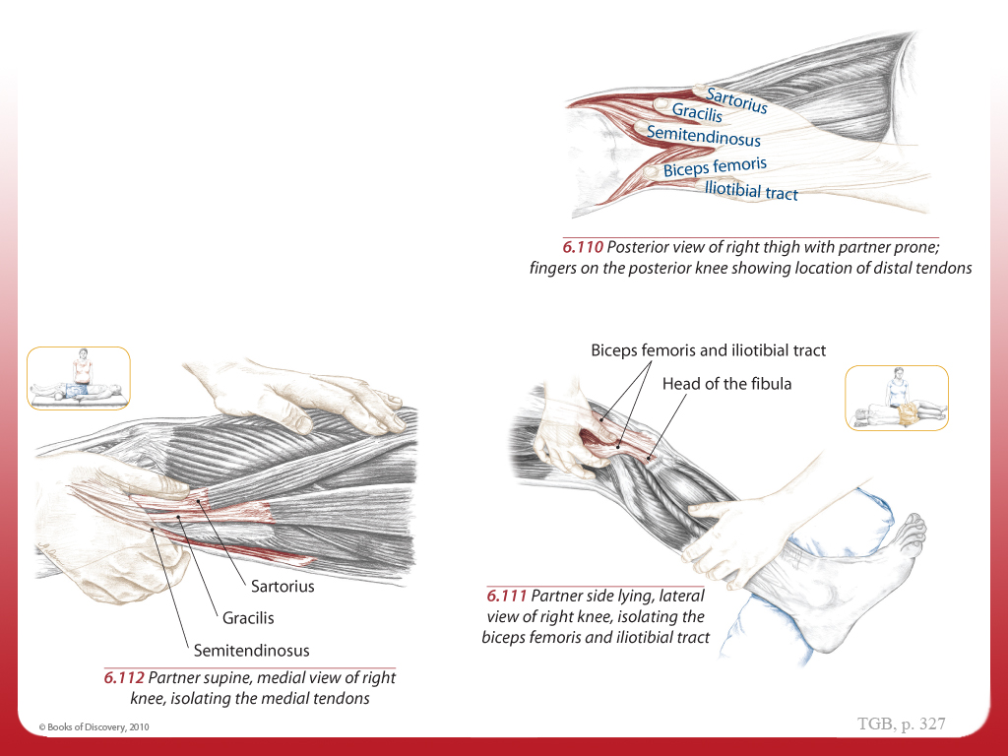
Tendons of the Posterior Knee, Lateral & Medial
Tendons of the Posterior Knee
Lateral tendons
Medial tendons

